Slide 1
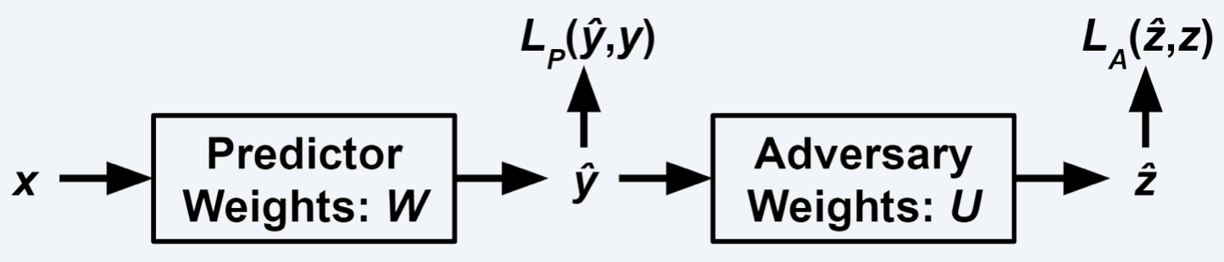
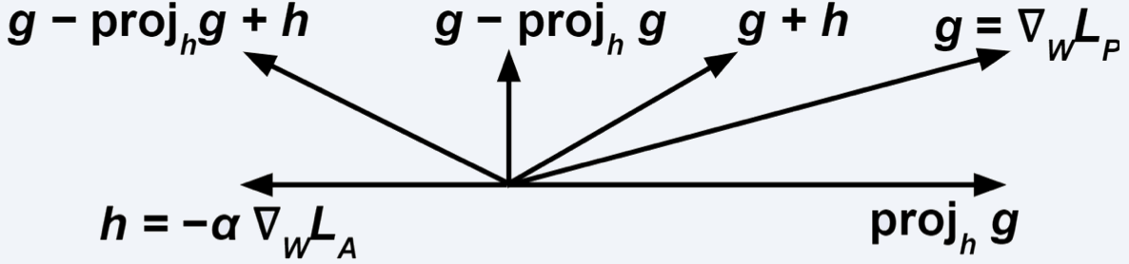
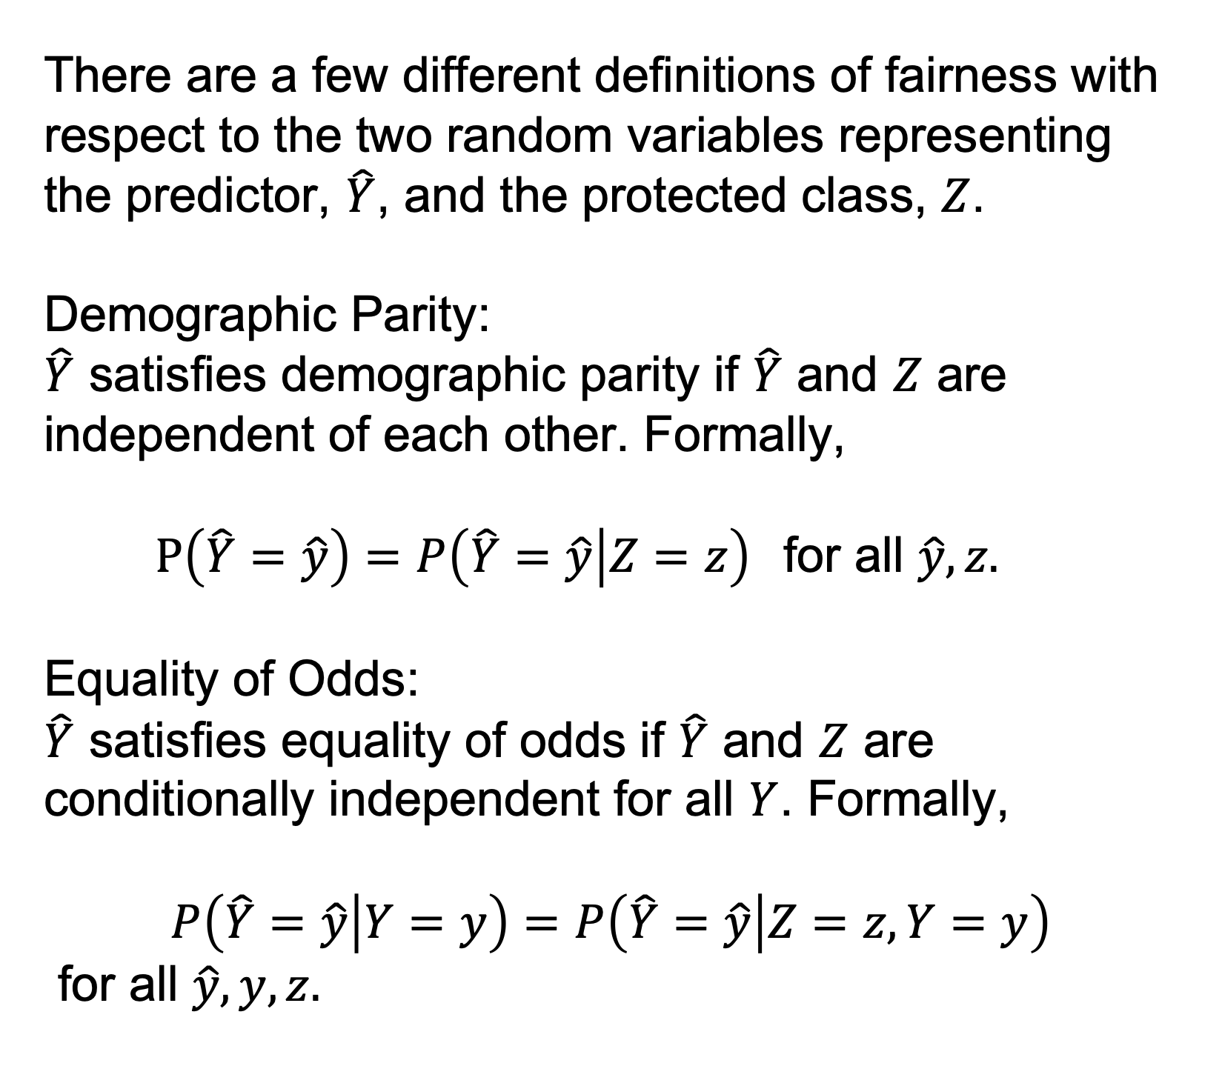
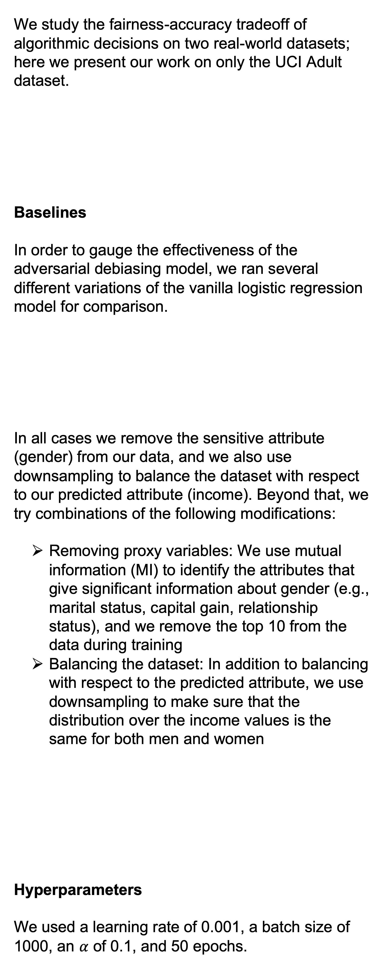
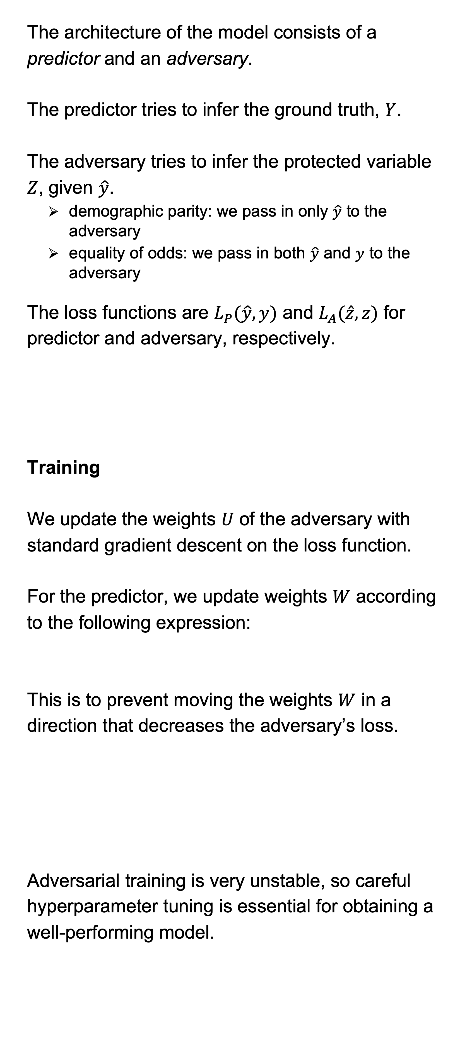
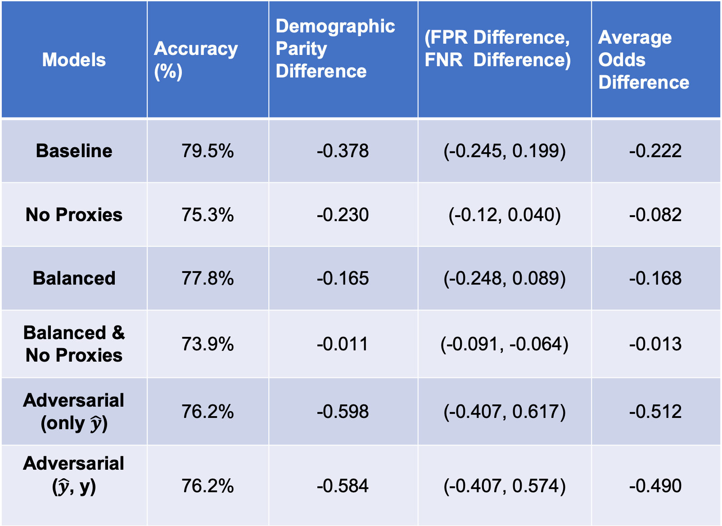
Investigating Models for Mitigating Bias
Sapna Kumari, Joe O’Connor, Archer Wang
Motivation
Adversarial Debiasing Algorithm
Experiments
Results
When dealing with real-world data, sometimes there are patterns in the data that reflect societal biases. If not done carefully, training a machine learning algorithm on this data will result in a model that makes biased predictions. These biased predictions can have serious negative and unfair consequences on the lives of real people, so it is imperative that fairness be taken into account when training these models.
We turn to a technique called adversarial debiasing. Simply removing a specific attribute will not mitigate the problem as there are proxy variables. And if we remove the proxy variables, this would harm accuracy simply from the absence of potentially useful data.
The architecture of the model consists of a
predictor and an adversary.
The predictor tries to infer the ground truth, $Y$.
The adversary tries to infer the protected variable
$Z$, given $\hat{y}$.
demographic parity: we pass in only $\hat{y}$ to the adversary
equality of odds: we pass in both $\hat{y}$ and $y$ to the adversary
The loss functions are $L_{P}(\hat{y}, y)$ and $L_{A}(\hat{z}, z)$ for
predictor and adversary, respectively.
Training
We update the weights $U$ of the adversary with
standard gradient descent on the loss function.
For the predictor, we update weights $W$ according
to the following expression:
This is to prevent moving the weights $W$ in a
direction that decreases the adversary’s loss.
Adversarial training is very unstable, so careful
hyperparameter tuning is essential for obtaining a
well-performing model.
We study the fairness-accuracy tradeoff of algorithmic decisions on two real-world datasets; here we present our work on only the UCI Adult dataset.
Baselines
In order to gauge the effectiveness of the adversarial debiasing model, we ran several different variations of the vanilla logistic regression model for comparison.
In all cases we remove the sensitive attribute (gender) from our data, and we also use downsampling to balance the dataset with respect to our predicted attribute (income). Beyond that, we try combinations of the following modifications:
Removing proxy variables: We use mutual information (MI) to identify the attributes that give significant information about gender (e.g., marital status, capital gain, relationship status), and we remove the top 10 from the data during training
Balancing the dataset: In addition to balancing with respect to the predicted attribute, we use downsampling to make sure that the distribution over the income values is the same for both men and women
Hyperparameters
We used a learning rate of 0.001, a batch size of 1000, an $α$ of 0.1, and 50 epochs.
We train six different variations of logistic regression model, with some combination of balancing the datasets, removing the proxy variables and adversarial debiasing model, and report accuracy and various fairness metrics on test dataset for each metric.
We find that we achieve the highest accuracy of 79.5% on the baseline model.
Removing proxy attributes leads to lower average odds difference but also leads to lower accuracy as proxy variables may be useful indicators of income.
Balancing the dataset and removing proxy variables leads to fairest outcomes but also the lowest accuracy. Thus, we see a tradeoff between accuracy and fairness.
Adversarial model led to poor fairness results due to issues with finetuning hyperparameters.
 | Females | Males
<$50k | 13026 (89%) | 20988 (69%)
>$50k | 1669 (11%) | 9539 (31%)
Models | Accuracy (%) | Demographic Parity Difference | (FPR Difference, FNR Difference) | Average Odds Difference
Baseline | 79.5% | -0.378 | (-0.245, 0.199) | -0.222
No Proxies | 75.3% | -0.230 | (-0.12, 0.040) | -0.082
Balanced | 77.8% | -0.165 | (-0.248, 0.089) | -0.168
Balanced & No Proxies | 73.9% | -0.011 | (-0.091, -0.064) | -0.013
Adversarial (only $\hat{y}$) | 76.2% | -0.598 | (-0.407, 0.617) | -0.512
Adversarial ($\hat{y}$, y) | 76.2% | -0.584 | (-0.407, 0.574) | -0.490
Background
 | Females | Males
<$50k | 4213 (72%) | 6995 (42%)
>$50k | 1669 (28%) | 9539 (58%)
Quantifying Fairness
There are a few different definitions of fairness with respect to the two random variables representing the predictor, $\hat{Y}$, and the protected class, $Z$.
Demographic Parity:
$\hat{Y}$ satisfies demographic parity if $\hat{Y}$ and $Z$ are independent of each other. Formally,
$P\left(\hat{Y}=\hat{y}\right)=P\left(\hat{Y}=\hat{y} | Z=z\right)$for all $\hat{y}, z.$
Equality of Odds:
$\hat{Y}$ satisfies equality of odds if $\hat{Y}$ and $Z$ are conditionally independent for all $Y$. Formally,
$$P\left(\hat{Y}=\hat{y} | Y=y\right)=P\left(\hat{Y}=\hat{y} | Z=z, Y=y\right)$$
for all $\hat{y}, y, z.$
To understand why the above notions of fairness are useful, think of demographic parity as mitigating bias in the data, and think of equality of odds as mitigating bias in the prediction algorithm.
Conclusion
Based on the above results, we conclude that in fact adversarial debiasing is not superior to simpler conventional approaches. Not only can we achieve good performance with the simpler methods, but achieving good performance with the adversarial model is unreasonably challenging, which makes it impractical as a standard method. That being said, debiasing machine learning algorithms in general is not yet a solved problem, and there is plenty more research to be done.
Dataset
 | Females | Males
<$50k | 1660 (50%) | 1678 (50%)
>$50k | 1669 (50%) | 1669 (50%)
UCI Adult: The classification task is to predict whether the income > 50K given various attributes of a person which includes:
categorical attributes such as education, occupation, age, nationality, marital status, gender, race etc.
continuous attributes such as number of education years, capital gain, hours per week etc.
Goal
We aim to evaluate the effectiveness of the adversarial model; in particular, we want to show whether adversarial debiasing is the best approach for decreasing bias while maintaining accuracy, or if other simpler approaches can achieve comparable performance.
References
Zhang, Brian Hu, et al. “Mitigating Unwanted Biases with Adversarial Learning.” ArXiv:1801.07593 [Cs], Jan. 2018. arXiv.org, http://arxiv.org/abs/1801.07593.

